Slide 1

Data Integration and Large Scale Analysis 02 Data Warehousing and ETL
Slides credit: Matthias Boehm
Last update: Oct 18, 2024

Slide 2


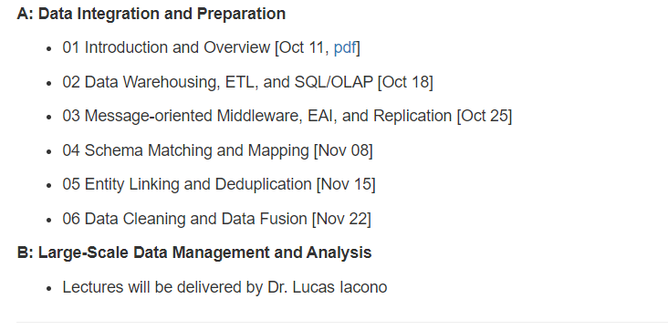
Announcements/Org
#1 Video Recording
Link in TUbe & TeachCenter
Optional attendance
In-person and video-recorded lectures
HS i5 or Webex: https://tugraz.webex.com/meet/shafaq.siddiqi
https://lucasiacono.github.io/ws2024_2025_dia.html
#2 Lectures Organization
Webex

Slide 3
Announcements/Org
#3 Grading
Mandatory Exercise of 30%
Final Exam of 70% on 7th Feb 2025 15:00 - 17:00 in HS i12
Possibility of an early exam for Erasmus and Exchange student
Written/oral
Announcement by the end of the year
#4 Office Hours
By appointment

Slide 4

Agenda
Data Warehousing (DWH)
Extraction, Transformation, Loading (ETL)
SQL/OLAP Extensions
Architecture & Logical Design
Physical Schema Design
ETL Pipeline Design
DWH Usage
SQL, SQL/OLAP, Data Mining, Machine Learning

Slide 5

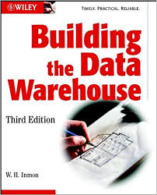
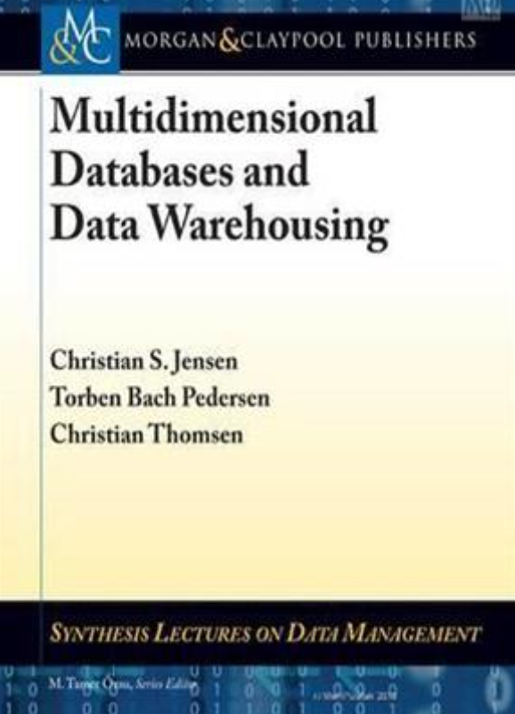
Data Warehousing
1. [Wolfgang Lehner: Datenbanktechnologie für Data-Warehouse-Systeme. Konzepte und Methoden, Dpunkt Verlag, 1-373, 2003]
2. [C. S. Jensen, T. B. Pedersen, C. Thomsen. Multidimensional Databases and Data Warehousing. Morgan and Claypool Publishers. 2010]

Slide 6
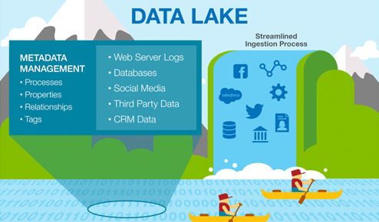




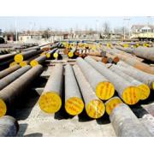

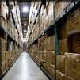
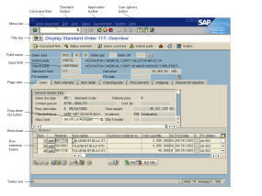
Integration Architecture
Data Warehousing
Distributed Computation
Frameworks
#1 Information System Pyramid
#2 Data Lake
Audio, Image, Video, Text, Streams, Logs
Operational Systems
Strategic Systems
Analytical Systems
DSS
Vertical Integration (e.g., ETL)
Catalogs
Distributed Data Stores
DWH
Material
ERP
CRM
SCM
eCommerce
Horizontal Integration (e.g., EAI)
Notes:
Integration Architecture

Slide 7
Motivation and Tradeoffs
Data Warehousing
Operational Systems
Analytical Systems
Goal: Queries over consolidated and cleaned data of several, potentially heterogeneous, data sources
Tradeoffs
Analytical query performance: write vs read optimized data stores
Virtualization: overhead of remote access, source systems affected
Consistency: sync vs async changes, time regime → up-to-date?
Others: history, flexibility, redundancy, effort for data exchange
?
OLTP (Online Transaction Processing)
vs OLAP (Online Analytical Processing)
Material
ERP
CRM
SCM
eCommerce

Slide 8



Data Warehouse Architecture
Data Warehousing
Data Mart 1
Data Mart 2
Data Mart 3
Analysis-centric independent subsets (e.g., geo, org, functional)
Data Warehouse
(consolidated raw data, aggregates, metadata)
Materialized, non-volatile integration
Staging Area
Async replication, and ETL vs ELT
Operational source systems
S₁
S₃
S₄
S₂

Slide 9
Data Warehouse Architecture, cont.
Data Warehousing
Data Warehouse (DWH)
“A data warehouse is a subject-oriented, integrated, time-varying, non-volatile collection of data in support of the management's decision-making process.” (Bill Inmon)
#1 Subject-oriented: analysis-centric organization (e.g., sales) → Data Mart
#2 Integrated: consistent data from different data sources
#3 Time-varying: History (snapshots of sources), and temporal modelling
#4 Non-volatile: Read-only access, limited to periodic data loading by admin
Different DWH Instantiations
Single DWH system with virtual/materialized views for data marts
Separate systems for consolidated DWH and aggregates/data marts (dependent data marts)
Data-Mart-local staging areas and ETL (independent data marts)

Slide 10
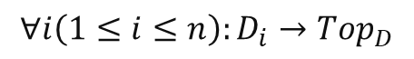
Multi-dimensional Modeling: Data Cube
Data Warehousing
Make
Central Metaphor: Data Cube
Qualifying data (categories, dimensions)
Quantifying data (cells)
Often sparse (0 for empty cells)
Multi-dimensional Schema
Set of dimension hierarchies (D¹,…, D^{n})
Set of measures (M¹,...,M^{m})
Dimension Hierarchy
Partially-ordered set D of categorical attributes ({D₁,...,D_{n}, Top_{D}};→)
Generic maximum element
Existing minimum element (primary attribute)
Location
Color
Top_{D}
Year
Quater
$$∀i\left(1≤i≤n\right):D_{i}→Top_{D}$$
Month
Week
$$∃i\left(1≤i≤n\right)∀j(1≤i≤n, i≠j):D_{i}→D_{j}$$
Day
Notes:
They record relevant events of a subject or functional area (facts) and the characteristics that define them (dimensions)
A fact in data warehousing describes quantitative transactional data like measurements, metrics, or the values ready for analysis. These include header numbers, order numbers, ticket numbers, transaction numbers, transaction currency, etc.
The amount sold is a fact measure or a key performance indicator (KPI). You can store this information in fact tables at the lowest level of granularity.

Slide 11
Multi-dimensional Modeling: Data Cube, cont.
Data Warehousing
Top
Dimension Hierarchy, cont.
Classifying (categorical) vs descriptive attributes
Orthogonal dimensions: there are no functional dependencies between attributes of different dimensions
Fact F
Base tuples w/ measures of summation type
Granularity G as subset of categorical attributes
Measure M
Computation function over non-empty subset of facts f(F₁, …, F_{k}) in schema
Scalar function vs aggregation function
Granularity G as subset of categorical attributes
Region
Nation
Addr
Customer
Status
Phone
Price
Order

Slide 12
Multi-dimensional Modeling: Operations
Data Warehousing
Slicing
Select a “slice” of the cube by specifying a filter condition on one of the dimensions (categorical attributes)
Same data granularity but subset of dimensions
Dicing
Select a “sub-cube” by specifying a filter condition on multiple dimensions
Complex Boolean expressions possible
Sometimes slicing used synonym
Example: Location=Graz AND Color=White AND Make=BMW

Slide 13
Multi-dimensional Modeling: Operations, cont.
Data Warehousing
Roll-up (similar Merge - remove dim)
Aggregation of facts or measures into coarser-grained aggregates (measures)
Same dimensions but different granularity
Drill-Down (similar Split add dim)
Disaggregation of measures into finer-grained measures
Roll-up
Drill-Down

Slide 14
Multi-dimensional Modeling: Operations, cont.
Data Warehousing
Drill-Across
Change from one cube to another
Drill-Through
Drill-Down to smallest granularity of underlying data store (e.g., RDBMS)
E.g., find relational tuples
Pivot
Rotate cube by exchanging dimensions
FName | LName | Local | Make | Color
Matthias | Boehm | Graz | BMW | White
… | … | … | … | …
Color
Location
Make
Location
Make
Color

Slide 15
Aggregation Types
Data Warehousing
Recap: Classification of Aggregates
Additive aggregation functions (SUM, COUNT)
Semi-additive aggregation functions (MIN, MAX)
Additively computable aggregation functions (AVG, STDDEV, VAR)
Aggregation functions (MEDIAN, QUANTILES)
Summation Types of Measures
FLOW: arbitrary aggregation possible
STOCK: aggregation possible, except over temporal dim
VPU: value-per-unit typically (e.g., price)
Necessary Conditions
Disjoint attribute values
Completeness
Type compatibility
[Hans-Joachim Lenz, Arie Shoshani: Summarizability in OLAP and Statistical Data Bases. SSDBM 1997]
[TUGraz online]
# Stud | 16/17 | 17/18 | 18/19 | 19/20 | 20/21 | Total
CS | 1,153 | 1,283 | 1,321 | 1,343 | 1368 | ?
SEM | 928 | 970 | 939 | 944 | 985 | ?
ICE | 804 | 868 | 846 | 842 | 849 | ?
Total | 2,885 | 3,121 | 3,106 | 3,129 | 3,202 | ?
Notes:
TU Graz: ~17000 students, is it correct to say CS-related 18% of students?
Statistics: bachelor and master
https://online.tugraz.at/tug_online/Studierendenstatistik.html?pAuswertung=8&pSJ=1664&pSemester=W&pGruppierung=1&pVerteilungsschluessel=TRUE

Slide 16

Excursus: Other Misleading Statistics
Data Warehousing
Problem Setting
100 people (90 vaccinated, 10 non-vaccinated)
5 infected vaccinated, 2 infected non-vaccinated
P(vacc|infected) = 5/7 = 0.71 → misleading
P(infected|vacc) = 5/90 = 0.056
P(infected|non-vacc) = 2/10 = 0.2
[https://twitter.com/howie_hua/ status/1421502809862664197]
[see also Simpson’s Paradox in 06 Data Cleaning]

Slide 17
Aggregation Types, cont.
Data Warehousing
Additivity
Type Compatibility (addition/ subtraction)
 | FLOW | STOCK: Temporal Agg? |  | VPU
 |  | Yes | No
MIN/MAX | ✔ | ✔ |  | ✔
SUM | ✔ | ✘ | ✔ | ✘
AVG | ✔ | ✔ |  | ✔
COUNT | ✔ | ✔ |  | ✔
 | FLOW | STOCK | VPU
FLOW | FLOW | STOCK | ✘
STOCK |  | STOCK | ✘
VPU |  |  | VPU

Slide 18
Data Cube Mapping and MDX
Data Warehousing
MOLAP (Multi-Dim. OLAP)
OLAP server with native multi-dimensional data storage
Dedicated query language: Multidimensional Expressions (MDX)
E.g., IBM Cognos Powerplay, Essbase
ROLAP (Relation OLAP)
OLAP server w/ storage in RDBMS
E.g., all commercial RDBMS vendors
HOLAP (Hybrid OLAP)
OLAP server w/ storage in RDBMS and multi-dimensional in-memory caches and data structures
[https://docs.microsoft.com/en-us/analysis-services/multidimensional-models/mdx]
SELECT {[Measures].[Sales], [Measures].[Tax]} ON COLUMNS,
{[Date].[Fiscal].[Year].&[2002],
[Date].[Fiscal].[Year].&[2003] } ON ROWS
FROM [Adventure Works]
WHERE ([Sales Territory].[Southwest])
Requires mapping to relational model
[Example systems: https://en.wikipedia.org/wiki/
Comparison_of_OLAP_servers]

Slide 19
Recap: Relational Data Model
Data Warehousing
Domain D (value domain): e.g., Set S, INT, Char[20]
Relation R
Relation schema RS: Set of k attributes {A₁,…,A_{k}}
Attribute A_{j}: value domain D_{j} = dom(A_{j})
Relation: subset of the Cartesian product over all value domains D_{j} R ⊆ D₁ × D₂ × ... × D_{k}, k ≥ 1
Additional Terminology
Tuple: row of k elements of a relation
Cardinality of a relation: number of tuples in the relation
Rank of a relation: number of attributes
Semantics: Set := no duplicate tuples (in practice: Bag := duplicates allowed)
Order of tuples and attributes is irrelevant
Attribute
A1 INT | A2 INT | A3 BOOL
3 | 7 | T
1 | 2 | T
3 | 4 | F
1 | 7 | T
Tuple
cardinality: 4
rank: 3

Slide 20
ROLAP – Star Schema
Data Warehousing
Product
Order
ProductID
ProdName
ProdDescr
Category
CategoryDescr
UnitPrice
OrderID
Order Date
Fact Table
Salesperson
OrderID
SalespersonID
CustomerID
ProdID
DateID
CityID
Quantity
Total Price
SalespersonID
SalespersonName
City
Quota
Date
DateID
Date
Customer
CustomerID
Customer Name
Customer Address
City
City
CityID
City
State
Country
Denormalized Dimension Tables
Notes:
Performance (few joins)
Redundancy due to denormalization
Update anomalies
Simplicity and tuning opportunities

Slide 21

ROLAP – Snowflake Schema
Data Warehousing
Product
Order
ProductID
ProdName
ProdDescr
CategoryName
UnitPrice
OrderID
Order Date
Category
Fact Table
CategoryName
CategoryDescr
Salesperson
OrderID
SalespersonID
CustomerID
ProdID
DateID
CityID
Quantity
Total Price
SalespersonID
SalespersonName
City
Quota
Date
Month
Year
DateID
Date
Month
Month
Year
Year
Customer
CustomerID
Customer Name
Customer Address
City
City
State
“Normalized” Dimension Tables
CityID
CityName
StateName
StateName
Country

Slide 22
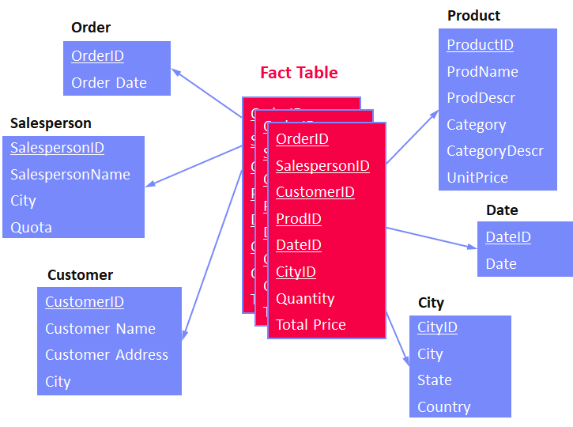
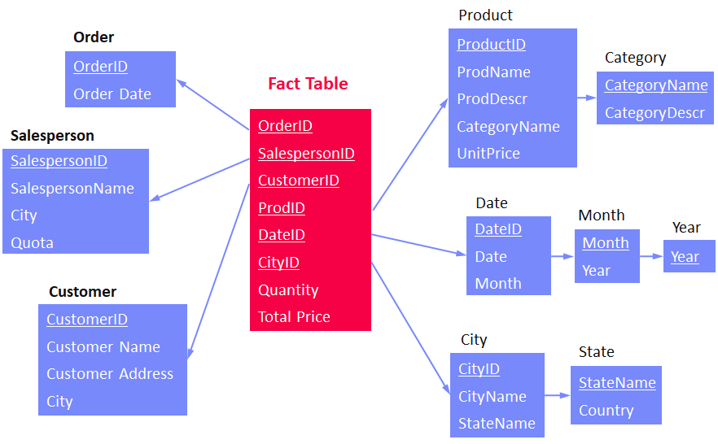
ROLAP – Other Schemas
Data Warehousing
Galaxy Schema
Similar to star-schema but with multiple fact tables and potentially shared dimension tables
Multiple stars → Galaxy
Snow-Storm Schema
Similar to snow-flake-schema but with multiple fact tables and potentially shared dimension tables
Multiple snow flakes → snow storm
OLAP Benchmark Schemas
TPC-H (8 tables, normalized schema)
SSB (5 tables, star schema, simplified TPC-H)
TPC-DS (24 tables, snow-storm schema)
[Raghunath Othayoth Nambiar, Meikel Poess: The Making of TPC- DS. VLDB 2006]
“TPC-D and its successors, TPC-H and TPC-R assumed a 3rd Normal Form (3NF) schema. However, over the years the industry has expanded towards star schema approaches.”

Slide 23
Evolution of DWH/OLAP Workloads
Data Warehousing
Goals: Advanced analytics and Operational BI
Reporting
Analysis
Forecasting
Operational BI
What did happen?
Why did it happen?
What will happen?
What happens right now?
SotA: Column stores w/ (multi-stage)
write buffers
Create reports with pre-defined queries.
Increasing number of ad-hoc queries.
Extension of the analytical model (advanced analytics).
Continuous streams of ad-hoc queries and propagated updates.
Step 1
Step 2
Step 3
Step 4
Batch
Adhoc
Analytics
Updates

Slide 24
BREAK (and Test Yourself)
Data Warehousing
[Exam Feb 08, 2021]
Task: Given below ER diagram, create a ROLAP star schema. Data types can be ignored, but indicate PK and FK constraints. (9/100 points)
Students
SID
FName
LName
Country
Exams (fact table)
Courses
CID
Title
ECTS
CatalogName
PID
ProfFName
ProfLName
SID
CID
DateID
Grade
Dates
DateID
Day
Month
Year

Slide 25
Extraction, Transformation, Loading (ETL)

Slide 26
Extract-Transform-Load (ETL) Overview
Extraction, Transformation, Loading (ETL)
Overview
ETL process refers to the overall process of obtaining data from the source systems, cleaning and transforming it, and loading it into the DWH
Subsumes many integration and cleaning techniques
#1 ETL
Extract data from heterogeneous sources
Transform data via dedicated data flows or in staging area
Load cleaned and transformed data into DWH
#2 ELT
Extract data from heterogeneous sources
Load raw data directly into DWH
Perform data transformations inside the DWH via SQL
➔ allows for automatic optimization of execution plans

Slide 27
Types of Heterogeneity
Extraction, Transformation, Loading (ETL)
[J. Hammer, M. Stonebraker, and O. Topsakal: THALIA: Test Harness for the Assessment of Legacy Information Integration Approaches. U Florida, TR05-001, 2005]
Heterogeneity
Semantic Heterogeneity
Structural Heterogeneity
Attribute Heterogeneity
Missing Data
1. Synonyms/Homonyms (Instructor vs lecturer)
6. Nulls (Missing Values)
9. Same Attribute in different structure
2. Simple Mapping (mathematical 12 hr vs 12 hr)
7. Virtual Columns
8. Semantic Incompatibility (Concept does not exist)
10. Handling Sets
3. Union Types (String, urls)
11. Attribute name does not define semantics
4. Complex Mappings (Units/Credits)
5. Language Expressions (Databse vs Datenbank)
12. Attribute composition

Slide 28
Corrupted Data
Extraction, Transformation, Loading (ETL)
Heterogeneity of Data Sources
Update anomalies on denormalized data / eventual consistency
Changes of app/preprocessing over time (US vs us) → inconsistencies
Human Error
Errors in semi-manual data collection, laziness (see default values), bias
Errors in data labeling (especially if large-scale: crowd workers / users)
Measurement/Processing Errors
Unreliable HW/SW and measurement equipment (e.g., batteries)
Harsh environments (temperature, movement) → aging
Uniqueness & duplicates
Contradictions & wrong values
Missing Values
[Credit: Felix Naumann]
Ref. Integrity
ID | Name | BDay | Age | Sex | Phone | Zip
3 | Smith, Jane | 05/06/1975 | 44 | F | 999-9999 | 98120
3 | John Smith | 38/12/1963 | 55 | M | 867-4511 | 11111
7 | Jane Smith | 05/06/1975 | 24 | F | 567-3211 | 98120
Zip | City
98120 | San Jose
90001 | Lost Angeles
Typos

Slide 29
ETL – Planning and Design Phase
Extraction, Transformation, Loading (ETL)
Architecture, Flows, and Schemas
#1 Plan requirements, architecture, tools
#2 Design high-level integration flows (systems, integration jobs)
#3 Data understanding (copy/code books, meta data)
#4 Design dimension loading (static, dynamic incl keys)
#5 Design fact table loading
Data Integration and Cleaning
#5 Types of data sources (snapshot, APIs, query language, logs)
#6 Prepare schema mappings → see 04 Schema Matching and Mapping
#7 Change data capture and incremental loading (diff, aggregates)
#8 Transformations, enrichments, and deduplication → 05 Entity Linking
#9 Data validation and cleansing → see 06 Data Cleaning and Data Fusion
Optimization
#10 Partitioning schemes for loaded data (e.g., per month)
#11 Materialized views and incremental maintenance

Slide 30
Events and Change Data Capture
Extraction, Transformation, Loading (ETL)
Goal: Monitoring operations of data sources for detecting changes
#1 Explicit Messages/Triggers
Setup update propagation from the source systems to middleware
Asynchronously propagate the updates into the DWH
#2 Log-based Capture
Parse system logs / provenance to retrieve changes since last loading
Sometimes combined w/ replication ➔ 03 MoM, EAI, and Replication
Leverage explicit audit columns or internal timestamps
#3 Snapshot Differences
Compute difference between old and new snapshot (e.g., files) before loading
Broadly applicable but more expensive

Slide 31
Example ETL Flow
Extraction, Transformation, Loading (ETL)
[Alkis Simitsis, Kevin Wilkinson, Petar Jovanovic: xPAD: a platform for analytic data flows. SIGMOD 2013]
Example Flows (Pentaho Data Integration, since 2015 Hitachi)
Other Tools
IBM IS, Informatica, SAP BO, MS Integration Services
Open Source: Pentaho Data Integration, Scriptella ETL, CloverETL, Talend
[Matthias Boehm, Uwe Wloka, Dirk Habich, Wolfgang Lehner:
GCIP: exploiting the generation and optimization of integration processes. EDBT 2009]

Slide 32
ETL via Apache Spark
Extraction, Transformation, Loading (ETL)
Example
Distributed ETL pipeline processing
[Xiao Li: Building Robust ETL Pipelines with Apache Spark, Spark Summit 2017]
//load csv and postgres tables
val csvTable = spark.read.csv("/source/path")
val jdbcTable = spark.read.format("jdbc")
.option("url", "jdbc:postgresql:...")
.option("dbtable", "TEST.PEOPLE")
.load()
//join tables, filter and write as parquet
csvTable
.join(jdbcTable, Seq("name"), "outer")
.filter("id <= 2999")
.write.mode("overwrite")
.format("parquet")
.saveAsTable("outputTableName")
11 Distributed, Data-Parallel Computation

Slide 33
SQL/OLAP Extensions

Slide 34
Overview Multi-Groupings
SQL/OLAP Extensions
Recap: GROUP BY
Group tuples by categorical variables
Aggregate per group
Grouping Extensions
Year | Quarter | Revenue
2004 | 1 | 10
2004 | 2 | 20
2004 | 3 | 10
2004 | 4 | 20
2005 | 1 | 30
SELECT Year, SUM(Revenue)
FROM Sales
GROUP BY Year
Year | SUM
2004 | 60
2005 | 30
GROUP BY
GROUPING SETS
ROLLUP
CUBE
GROUPING

Slide 35
Grouping Sets
SQL/OLAP Extensions
GROUP BY GROUPING SETS ((<attribute-list>), …)
Semantics
Grouping by multiple group-by attribute lists w/ consistent agg function
Equivalent to multiple GROUP BY, connected by UNION ALL
Example
SELECT Year, Quarter, SUM(Revenue)
FROM R
GROUP BY GROUPING SETS ((), (Year), (Year,Quarter))
Year | Quarter | SUM
- | - | 90
2004 | - | 60
2005 | - | 30
2004 | 1 | 10
2004 | 2 | 20
2004 | 3 | 10
2004 | 4 | 20
2005 | 1 | 30
Year | Quarter | Revenue
2004 | 1 | 10
2004 | 2 | 20
2004 | 3 | 10
2004 | 4 | 20
2005 | 1 | 30

Slide 36
Rollup (see also multi-dim ops)
SQL/OLAP Extensions
GROUP BY ROLLUP (<attribute-list>)
Semantics
Hierarchical grouping along dimension hierarchy
GROUP BY ROLLUP (A1,A2,A3) := GROUP BY GROUPING SETS((),(A1),(A1,A2),(A1,A2,A3))
Example
SELECT Year, Quarter, SUM(Revenue)
FROM R
GROUP BY ROLLUP(Year,Quarter)
Year | Quarter | SUM
- | - | 90
2004 | - | 60
2005 | - | 30
2004 | 1 | 10
2004 | 2 | 20
2004 | 3 | 10
2004 | 4 | 20
2005 | 1 | 30
Year | Quarter | Revenue
2004 | 1 | 10
2004 | 2 | 20
2004 | 3 | 10
2004 | 4 | 20
2005 | 1 | 30

Slide 37
Rollup, cont. and Grouping
SQL/OLAP Extensions
∪
Operator Implementation
Aggregation towers for (semi-)additive aggregation functions
Example
GROUPING Semantics
With ROLLUP or CUBE to identify aggregates
NULL group vs NULL due to aggregation
Example
γ_{sum()}
γ_{Year;sum()}
SELECT Year, Quarter, SUM(Revenue)
FROM R
GROUP BY ROLLUP(Year,Quarter)
γ_{Year,Quarter;sum()}
R
Team | Revenue | Agg
NULL | 10 | 0
Sales | 40 | 0
Tech | 20 | 0
NULL | 70 | 1
SELECT Team, SUM(Revenue), GROUPING(Team) AS Agg
FROM R
GROUP BY ROLLUP (Team)

Slide 38
Cube
SQL/OLAP Extensions
GROUP BY CUBE(<attribute-list>)
Semantics
Computes aggregate for all 2^{n} combinations for n grouping attributes
Equivalent to enumeration via GROUPING SETS
Example
Year | Quarter | SUM
- | - | 90
2004 | - | 60
2005 | - | 30
- | 1 | 40
- | 2 | 20
- | 3 | 10
- | 4 | 20
2004 | 1 | 10
2004 | 2 | 20
2004 | 3 | 10
2004 | 4 | 20
2005 | 1 | 30
SELECT Year, Quarter, SUM(Revenue)
FROM R
GROUP BY CUBE(Year,Quarter)
Year | Quarter | Revenue
2004 | 1 | 10
2004 | 2 | 20
2004 | 3 | 10
2004 | 4 | 20
2005 | 1 | 30

Slide 39
Cube, cont.
SQL/OLAP Extensions
{}
Operator Implementation
Aggregation lattice for (semi-)additive aggregation functions
But: multiple alternative paths → how to select the cheapest?
Recap: Physical Group-By Operators
SortGroupBy / -Aggregate
HashGroupBy / -Aggregate
Cube Implementation Strategies
#1: Some operators can share sorted order (e.g., {A,B} -> {A})
#2: Subsets with different cardinality → pick smallest intermediates
{A}
{B}
{C}
{A,B}
{A,C}
{B,C}
{A,B,C}

Slide 40
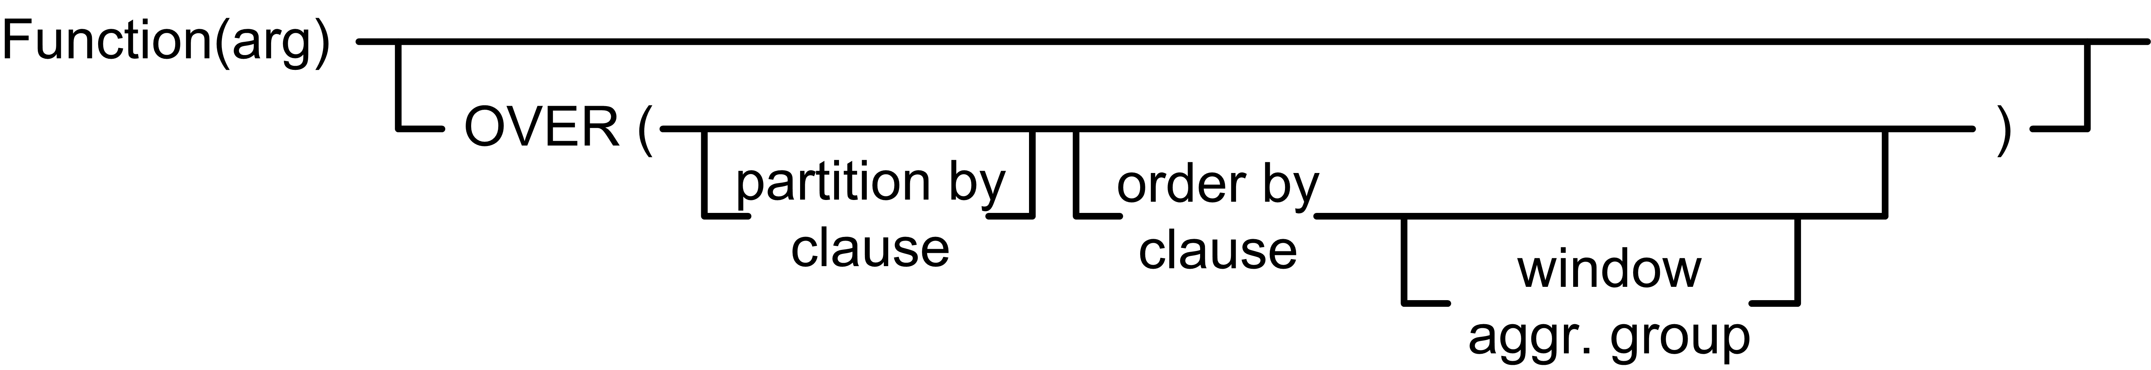
Overview Reporting Functions
SQL/OLAP Extensions
Motivation and Problem
Scalar functions as well as grouping + aggregation
For many advanced use cases not flexible enough
Reporting Functions
Separate partitioning (grouping) and aggregation via OVER
Allows local partitioning via windows and ranking/numbering
optional
Aggregation function
Partitioning (similar to GROUP BY)
Sorting order per partition
Window definition wrt current tuple

Slide 41
RF – Aggregation Function
SQL/OLAP Extensions
Semantics
Operates over window and returns value for every tuple
RANK(), DENSE_RANK(), PERCENT_RANK(), CUME_DIST(), ROW_NUMBER()
Example
SELECT Year, Quarter, RANK() OVER (ORDER BY Revenue ASC) AS Rank1, DENSE_RANK() OVER (ORDER BY Revenue ASC) AS DRank1,
FROM R
Year | Quarter | Revenue
2004 | 1 | 10
2004 | 2 | 20
2004 | 3 | 10
2004 | 4 | 20
2005 | 1 | 30
Year | Quarter | Rank1 | DRank1
2004 | 1 | 1 | 1
2004 | 3 | 1 | 1
2004 | 2 | 3 | 2
2004 | 4 | 3 | 2
2005 | 1 | 5 | 3
OVER() represents all tuples

Slide 42
RF – Partitioning
SQL/OLAP Extensions
Semantics
Select tuples for aggregation via PARTITON BY <attribute-list>
Example
SELECT Year, Quarter, Revenue,
SUM(Revenue) OVER(PARTITION BY Year)
FROM R
Year | Quarter | Revenue
2004 | 1 | 10
2004 | 2 | 20
2004 | 3 | 10
2004 | 4 | 20
2005 | 1 | 30
Year | Quarter | Revenue | SUM
2004 | 1 | 10 | 60
2004 | 2 | 20 | 60
2004 | 3 | 10 | 60
2004 | 4 | 20 | 60
2005 | 1 | 30 | 30

Slide 43


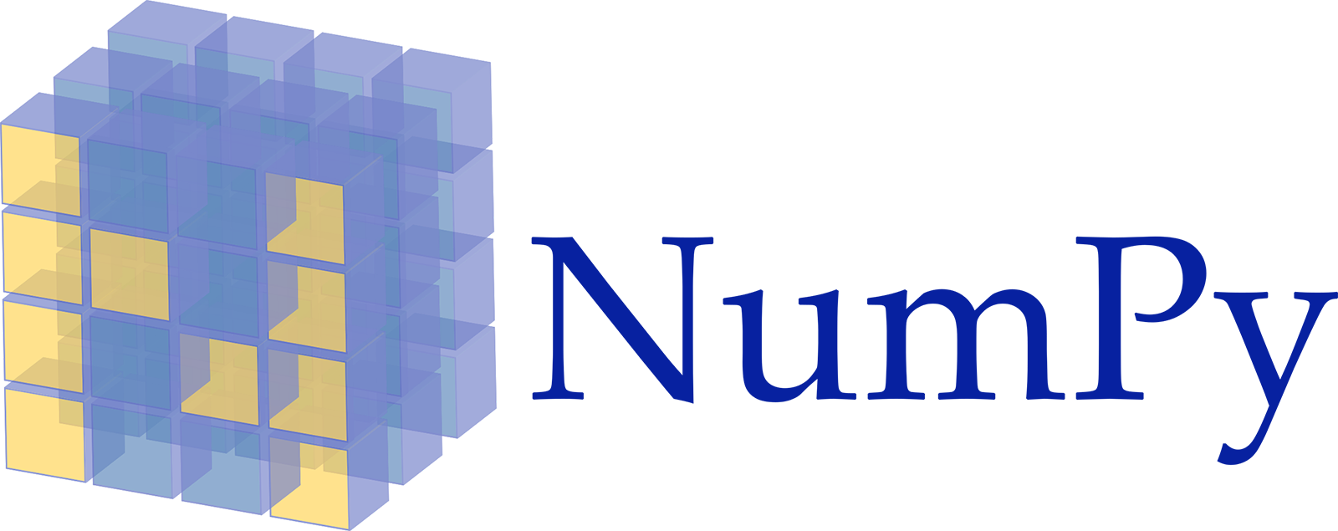

RF – Partition Sorting
SQL/OLAP Extensions
Semantics
Define computation per partition via ORDER BY <attribute-list>
Note: ORDER BY allows cumulative computation → cumsum()
Example
SELECT Year, Quarter, Revenue, SUM(Revenue) OVER(PARTITION BY Year ORDER BY Quarter)
FROM R
Year | Quarter | Revenue
2004 | 1 | 10
2004 | 2 | 20
2004 | 3 | 10
2004 | 4 | 20
2005 | 1 | 30
Year | Quarter | Revenue | SUM
2004 | 1 | 10 | 10
2004 | 2 | 20 | 30
2004 | 3 | 10 | 40
2004 | 4 | 20 | 60
2005 | 1 | 30 | 30

Slide 44
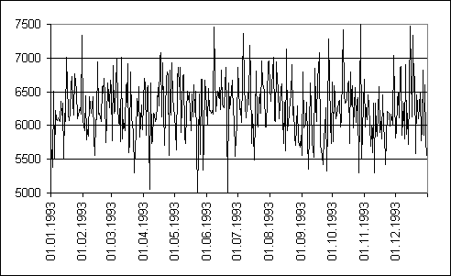
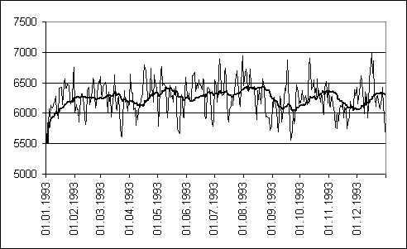
RF – Windowing
SQL/OLAP Extensions
Measurements
Semantics
Define window for computation (e.g., for moving average, cumsum)
Example
Moving AVGs
SELECT Year, Quarter, Revenue, AVG(Revenue) OVER (ORDER BY Year, Quarter
ROWS BETWEEN 1 PRECEDING AND CURRENT ROW)
FROM R
Year | Quarter | Revenue
2004 | 1 | 10
2004 | 2 | 20
2004 | 3 | 10
2004 | 4 | 20
2005 | 1 | 30
Year | Quarter | Revenue | AVG
2004 | 1 | 10 | 10
2004 | 2 | 20 | 15
2004 | 3 | 10 | 15
2004 | 4 | 20 | 15
2005 | 1 | 30 | 25

Slide 45
Trend: Cloud Data Warehousing
Data Warehousing
10 Distributed Data Storage
#1 Google Big Query
#2 Amazon Redshift
#3 Microsoft Azure Data Warehouse
#4 IBM BlueMix dashDB
#5 Snowflake Data Warehouse
[Google, Kazunori Sato: An Inside Look at Google BigQuery, Google White Paper 2012]
[Anurag Gupta, Deepak Agarwal, Derek Tan, Jakub Kulesza, Rahul Pathak, Stefano Stefani, Vidhya Srinivasan: Amazon Redshift and the Case for Simpler Data Warehouses. SIGMOD 2015]
[IBM: IBM dashDB - Cloud-based data warehousing as-a-service, built for analytics, IBM White Paper 2015]
[Benoît Dageville et al.: The Snowflake Elastic Data Warehouse. SIGMOD 2016]

Slide 46
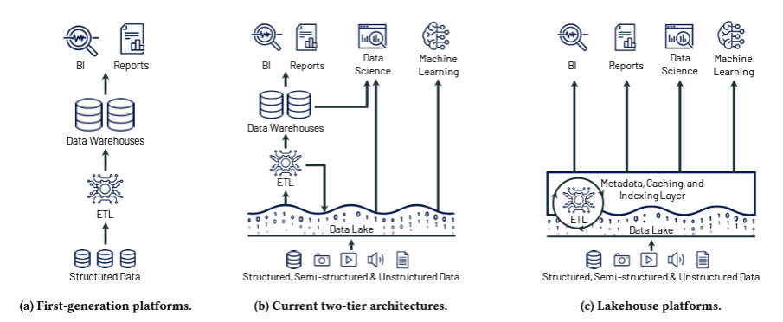
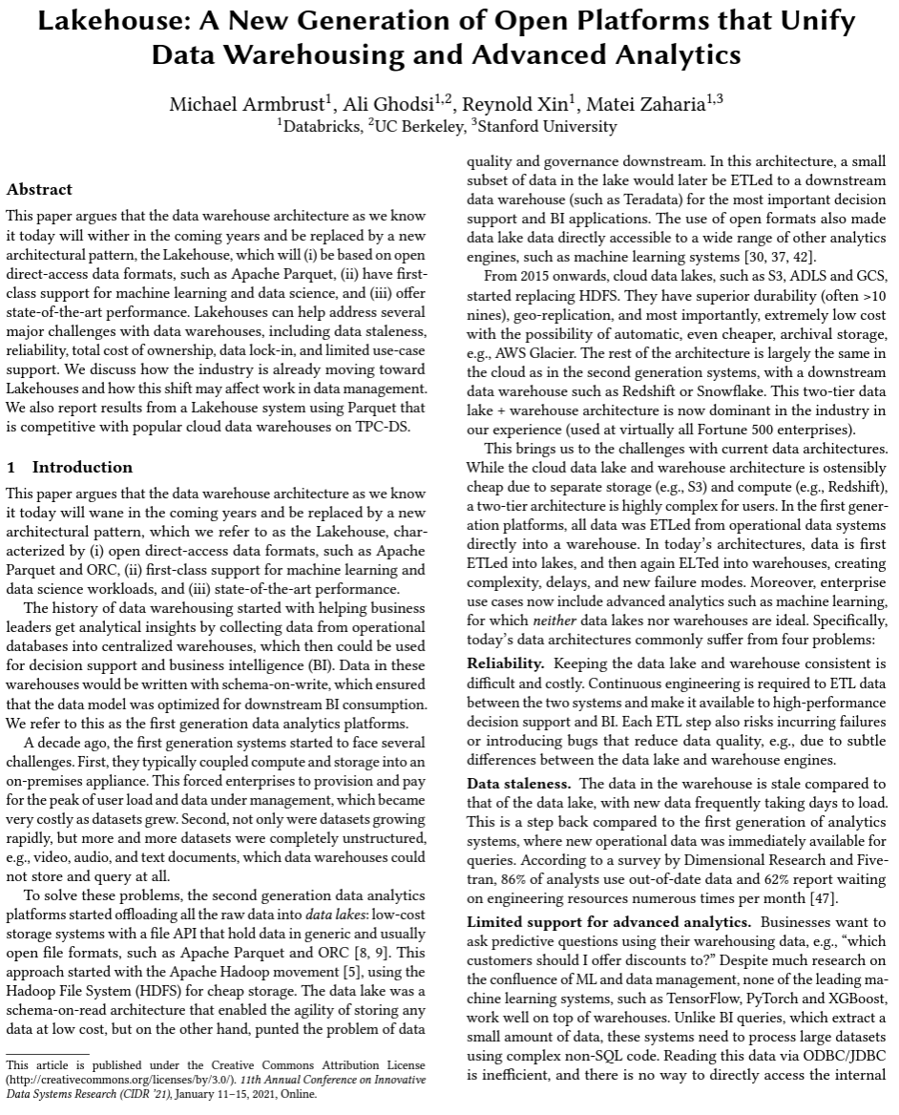
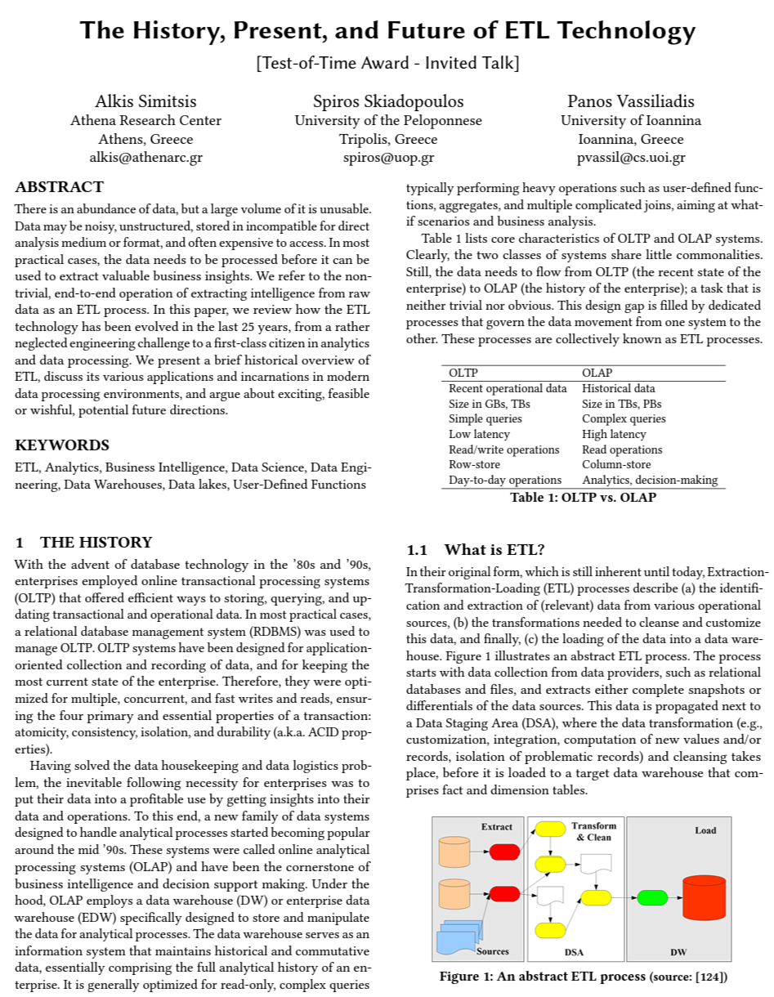
Trend: Data Lakes and Lakehouse
Data Warehousing
10 Distributed Data Storage
[Matei Zahari et. al, Lakehouse: A New Generation of Open Platforms that Unify Data Warehousing and Advanced Analytics. CIDR 2021]
[Alkis Simitsis et. al., The History, Present, and Future of ETL Technology, DOLAP 2023]

Slide 47
Summary and Q&A
“There is a profound cultural assumption in the business world that if only we could see all of our data, we could manage our businesses more effectively. This cultural assumption is so deeply rooted that we take it for granted. Yet this is the mission of the data warehouse, and this is why the data warehouse is a permanent entity […] even as it morphs and changes its shape.” -- Ralph Kimball, Joe Caserta; 2004
Data Warehousing (DWH)
DWH architecture
Multidimensional modeling
Extraction, Transformation, Loading (ETL)
ETL process, errors, and data flows
SQL/OLAP Extensions
Multi-grouping operations
Reporting functions
Next Lectures (Data Integration Architectures)
03 Message-oriented Middleware, EAI, and Replication [Oct 25]
04 Schema Matching and Mapping [Nov 01]

